Slide 1
Practice: Logisim (Week 3)

Slide 2
Logisim

Slide 3
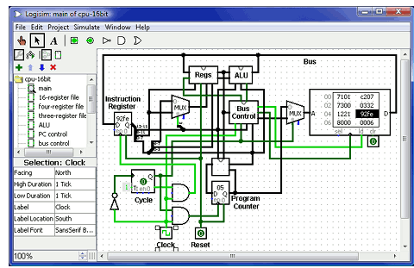
Logisim
An open-source graphical tool for designing and simulating logic circuits.
Using these logic circuits, we will make components composing a computer.
Notes:
Next chapter, Ealier Technology, will be helpful to understand SASMvm more easily.

Slide 4
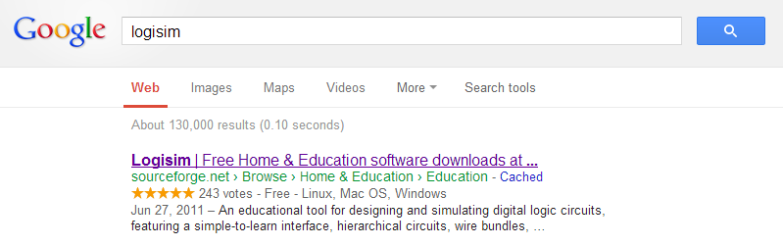
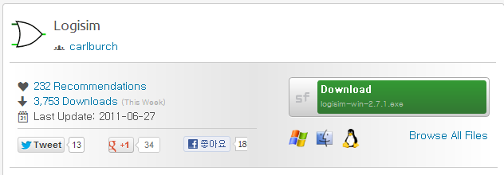
Installation
Google search
Download file
Notes:
Next chapter, Ealier Technology, will be helpful to understand SASMvm more easily.

Slide 5
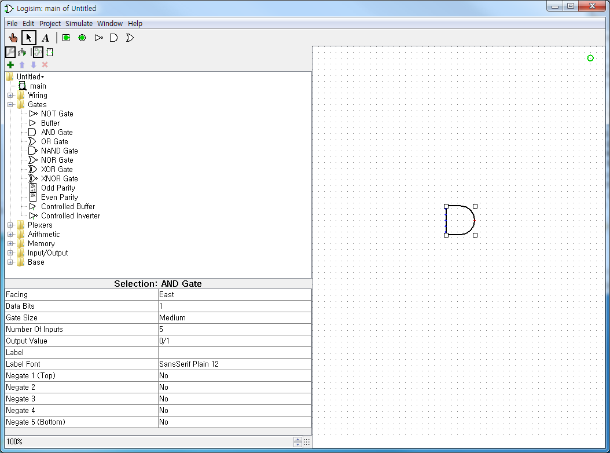
Basic Usage
Visualize Logic circuits
Logic circuits provided by ‘Logisim’
Properties of the circuit
Notes:
Next chapter, Ealier Technology, will be helpful to understand SASMvm more easily.

Slide 6

Basic Usage
Menu for editing circuit
 | Change values within circuit
 | Edit selection and add wires
 | Edit text in circuit
 | Add Pin for input
 | Add Pin for output
 | Add (NOT, AND, OR) gate
Notes:
Next chapter, Ealier Technology, will be helpful to understand SASMvm more easily.

Slide 7

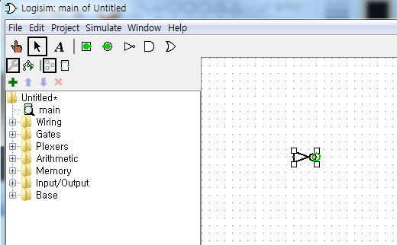
Basic Usage
Draw a gate
Click
Click

Slide 8


Basic Usage
Draw input, output
Click
Click
Click
Click

Slide 9



Basic Usage
Add wires
Click & Drag
Drop
Add wire from gate to output

Slide 10

Basic Usage
Change input value
Click

Slide 11
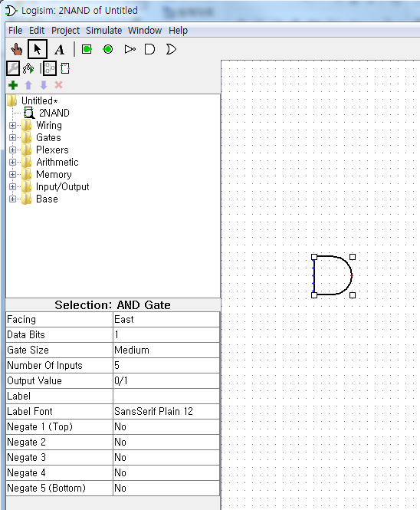
Basic Usage
Edit properties
1. Click!
2. Edit properties

Slide 12
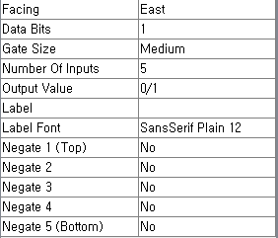
Basic Usage
Edit properties
해당 개체의 방향(90도 씩 회전한 것과 같은 효과)
Data의 Bit 수
회로에서 보이는 개체의 크기
Input pin의 개수
Output 값의 종류(우리는 0/1로 고정)
개체의 이름
개체의 이름을 보여주는 폰트
각 Input을 negate 시키는지 여부

Slide 13
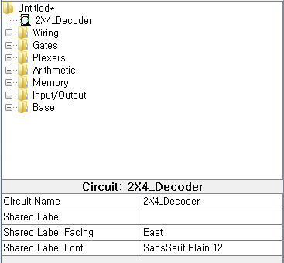
Basic Usage
Edit circuit name
Click circuit name
Edit circuit name on property window
1. Click!
2. Edit circuit name
Notes:
Next chapter, Ealier Technology, will be helpful to understand SASMvm more easily.

Slide 14
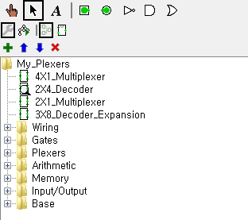
Basic Usage
Add circuits on the project
Click icon
Click!
Notes:
Next chapter, Ealier Technology, will be helpful to understand SASMvm more easily.

Slide 15

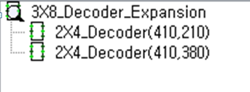
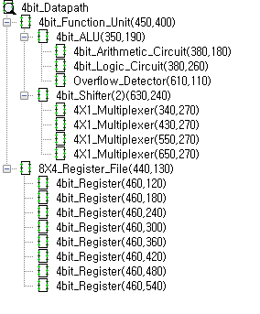
Basic Usage
See hierarchy
Hierarchy in explorer pane

Slide 16
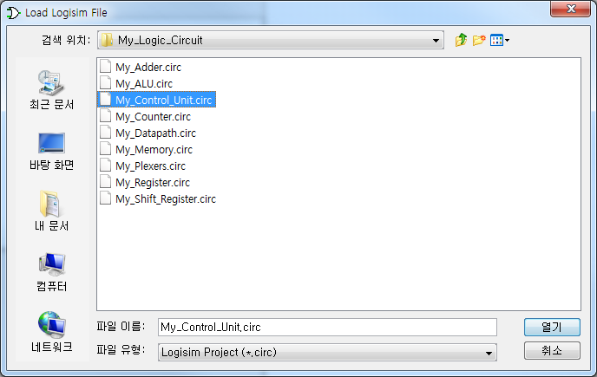
Basic Usage
Load circuit
Project → Load library → Logisim Library
Select the file you want to load

Slide 17
Practice

Slide 18
Practice 1
Draw & test circuits(compare to truth table)
(you can use AND, OR, NOT gates only)
2-input AND
2-input OR
NOT
2-input NAND
2-input NOR
2-input XOR
3-input AND
2-input 4-bit AND (change data bit)
Notes:
Next chapter, Ealier Technology, will be helpful to understand SASMvm more easily.

Slide 19
Practice 2
Draw & test circuits(compare to truth table)
Half Adder
Full Adder (use basic gates only)
Full Adder (use half adder you made)
Notes:
Next chapter, Ealier Technology, will be helpful to understand SASMvm more easily.

Slide 20
Practice 3
Draw & test circuits(compare to truth table)
2-to-1 Multiplexer
2-to-4 Decoder (with enable input)
4-to-1 Multiplexer (use basic gates only)
4-to-1 Multiplexer (use 2-to-1 Multiplexer)
4-to-1 Multiplexer (use 2-to-4 Decoder)
3-to-8 Decoder (use 2-to-4 Decoder)
Notes:
Next chapter, Ealier Technology, will be helpful to understand SASMvm more easily.

